Slide 1


Project 5781 : fundamentals of software security Subject n°5: Automatic solver of simple challenge
Names of Authors : Joss Lalou and Nathane Baranes
Name of teacher : Arie Haenel

Slide 2

presentation program
I) Introduction
II) Symbolic execution summary
III) limitations and disadvantages of symbolic execution
IV)Angr
V) Explication of our project
VI) Conclusion
VII) DEMO

Slide 3
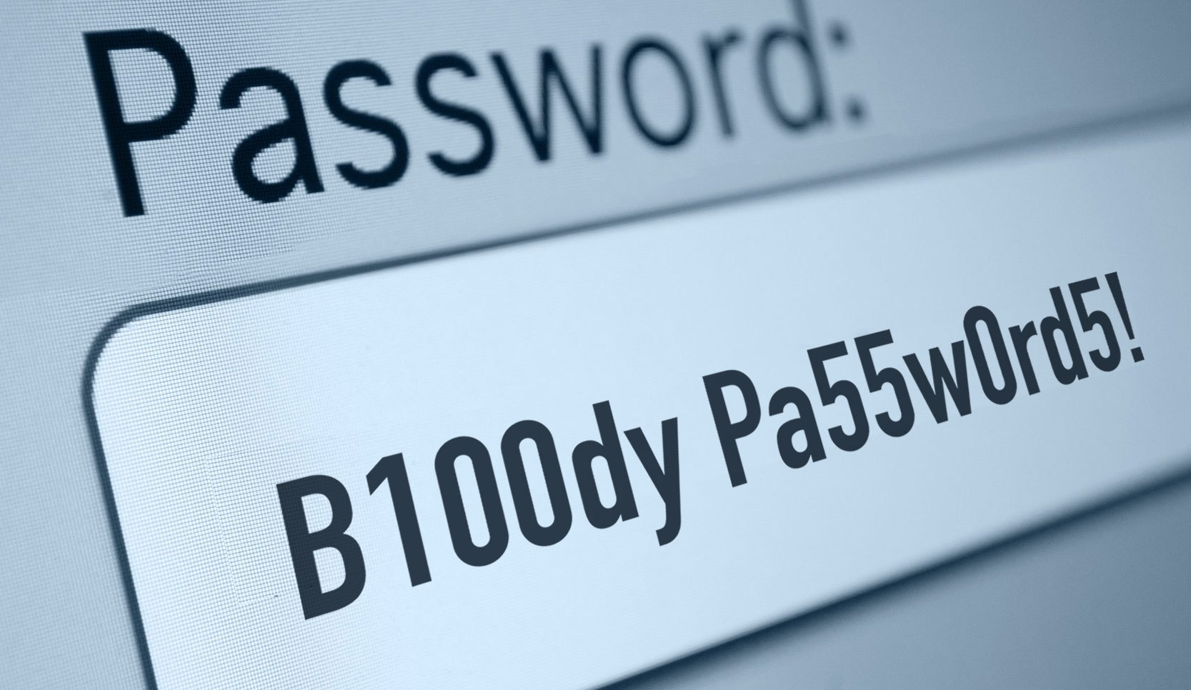



Introduction

Slide 4
I) Symbolic execution summary

Slide 5
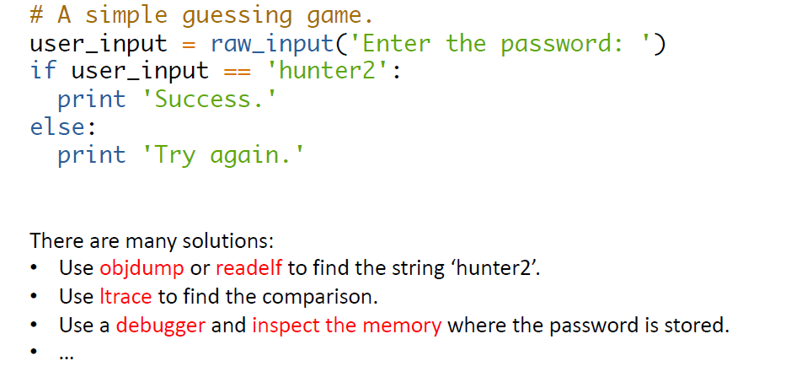
A Simple Capture-the-Flag Level
(ltrace is a debugging utility in Linux, used to display the calls a userspace application makes to shared libraries.)

Slide 6
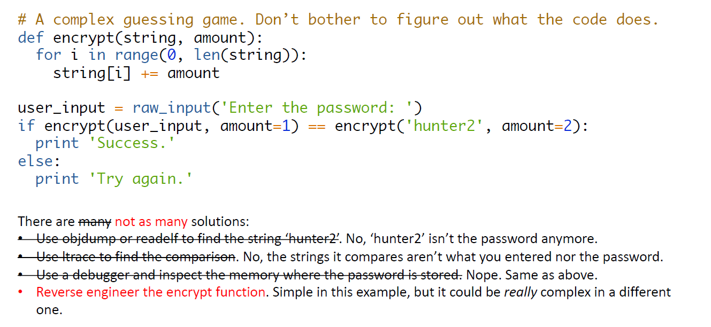
A Complex Capture-the-Flag Level

Slide 7
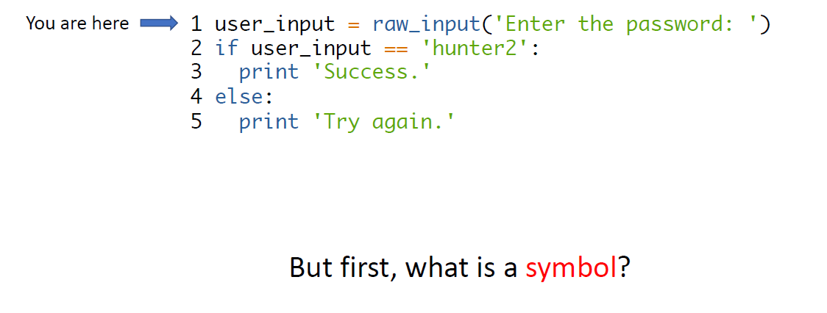
Step 1: Inject a Symbol

Slide 8
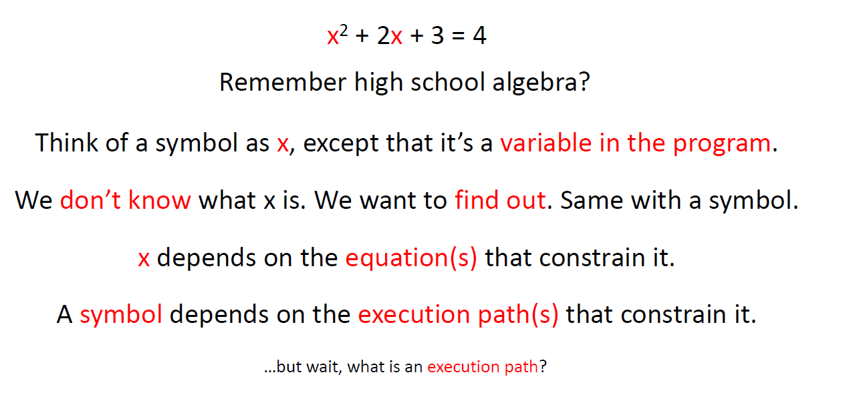
What is a Symbol?

Slide 9
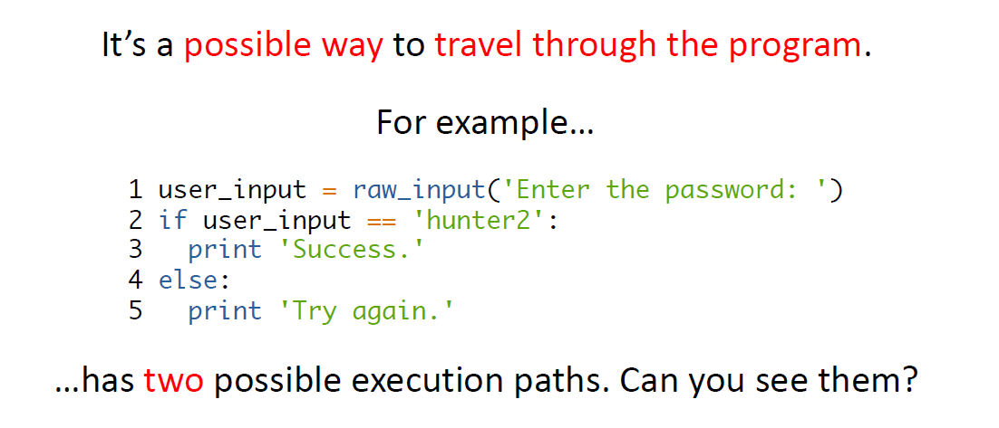
What is an Execution Path?

Slide 10
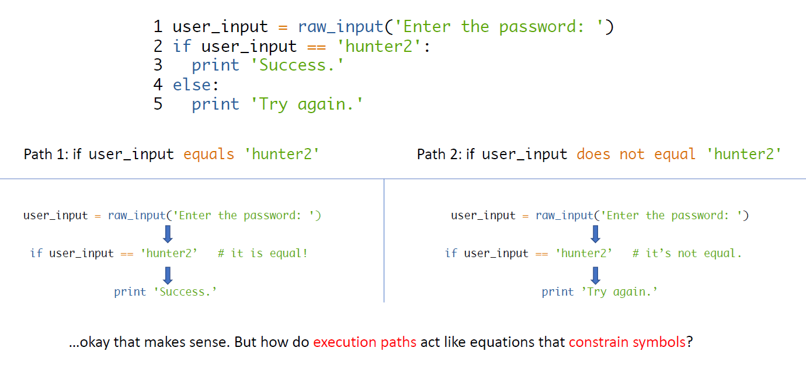
Execution Path Example

Slide 11
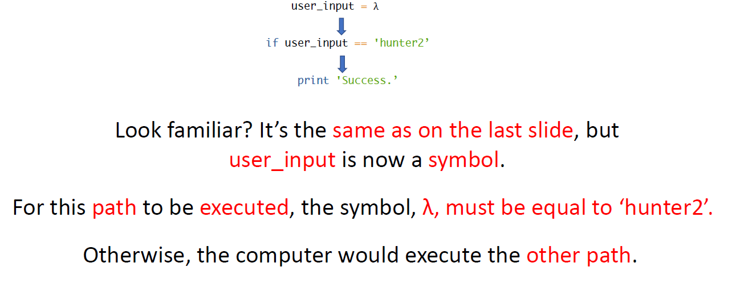
How do execution paths constrain symbols?

Slide 12
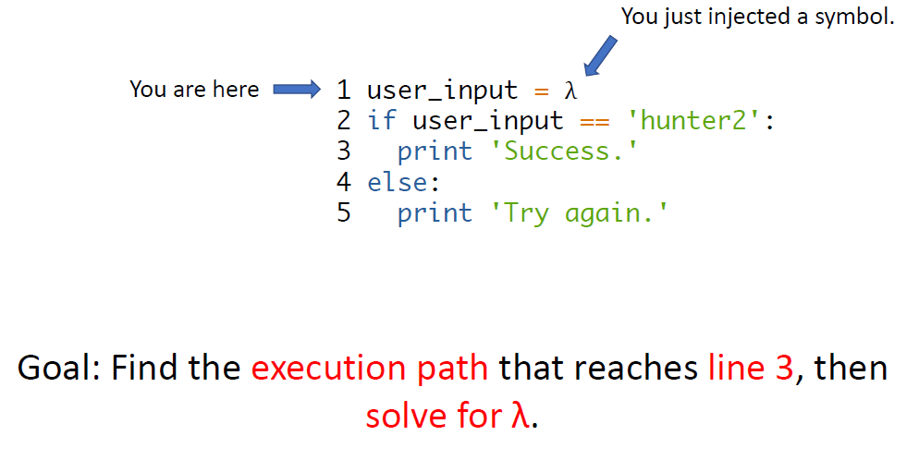
Return to Step 1: Inject a Symbol

Slide 13
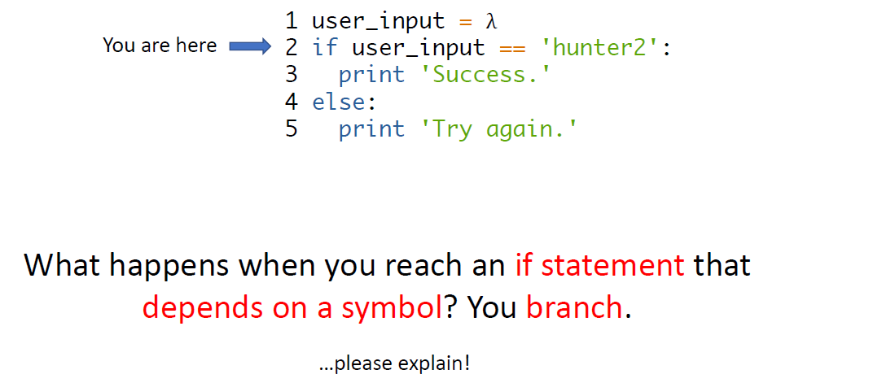

Step 2: Branch

Slide 14
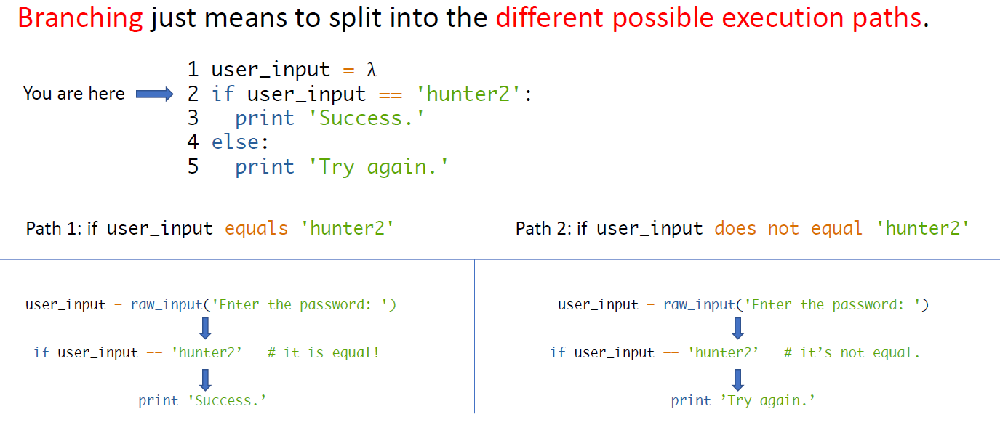
What does it mean to branch?

Slide 15
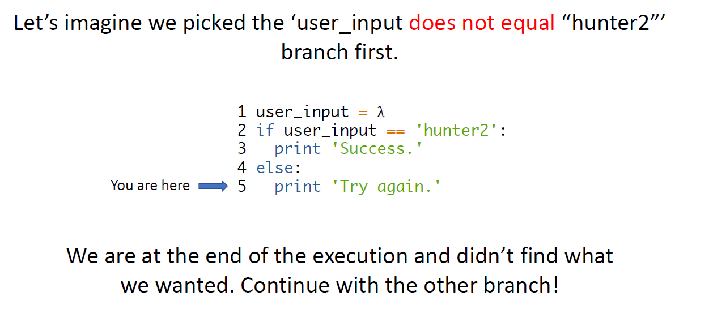
Step 3: Evaluate each Branch

Slide 16
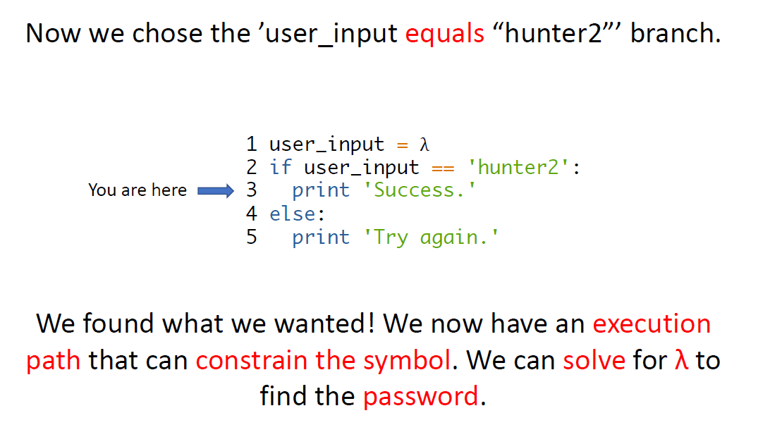
Step 3: Evaluate each Branch (part 2)

Slide 17
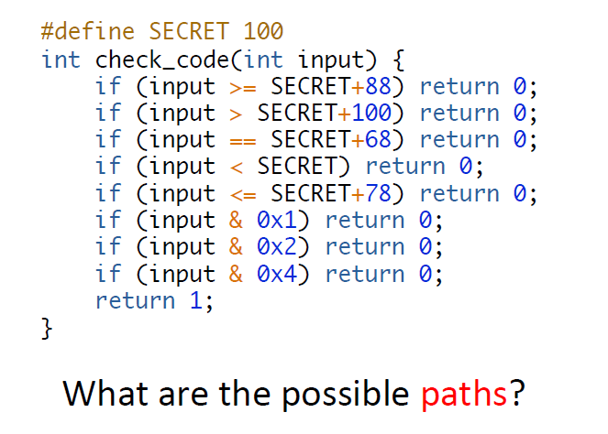
A More Complex Example: Part 1

Slide 18
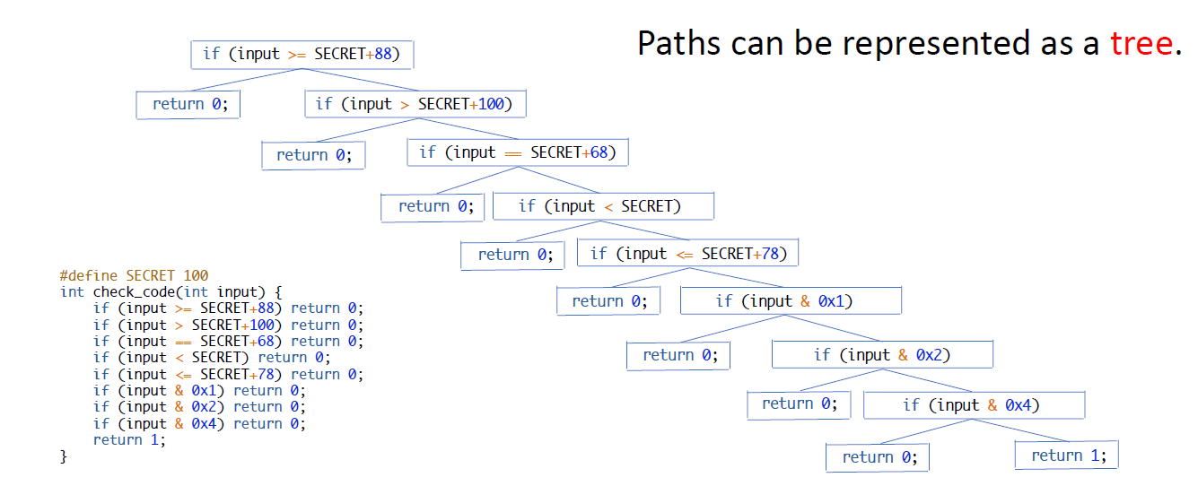
A More Complex Example: Part 2

Slide 19
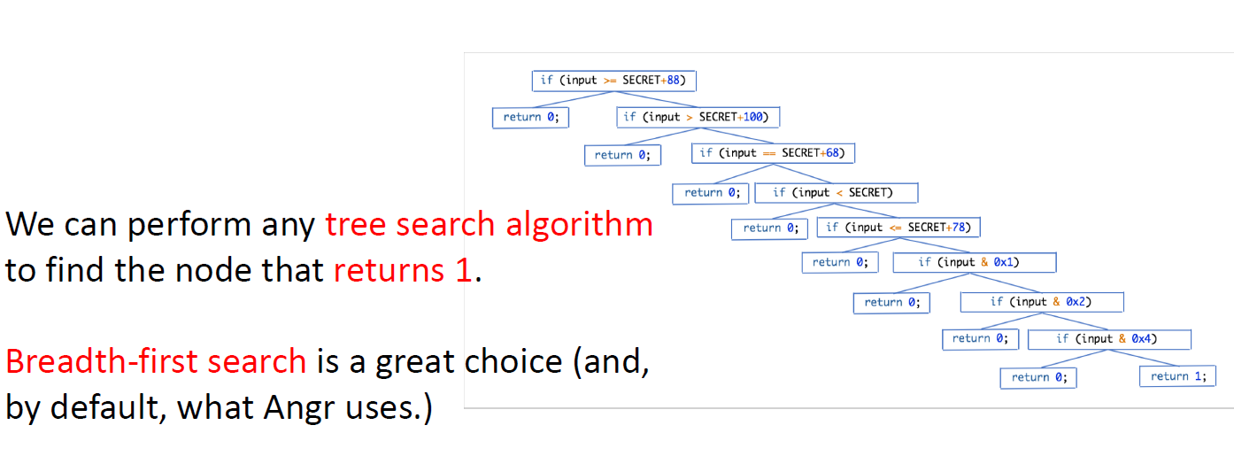
Solving a More Complex Example: Part 1

Slide 20
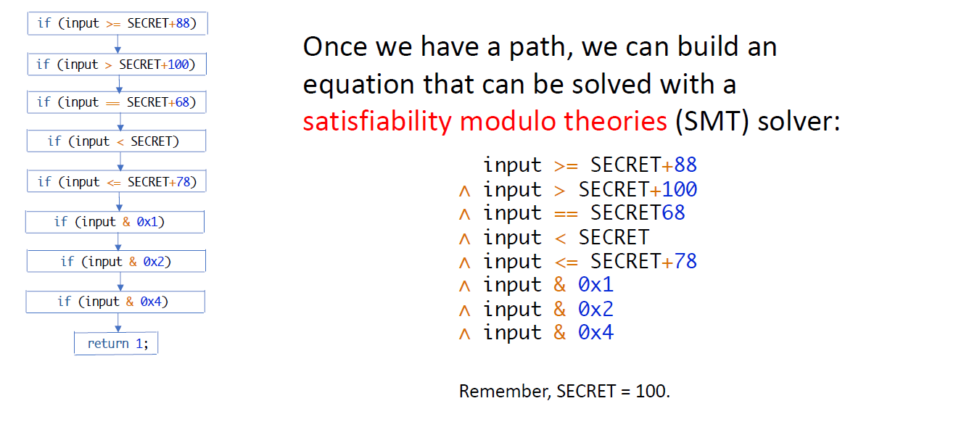
Solving a More Complex Example: Part 2

Slide 21
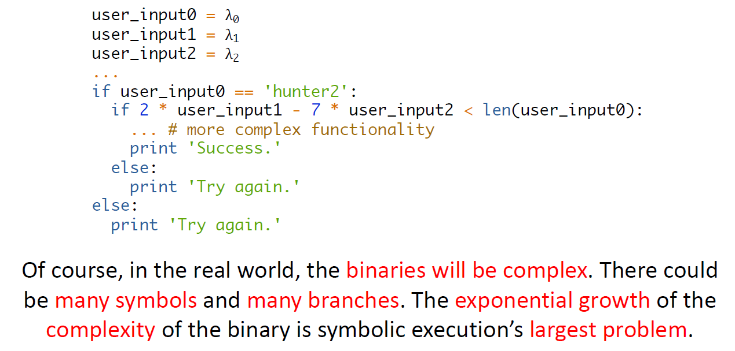
The Real World™

Slide 22
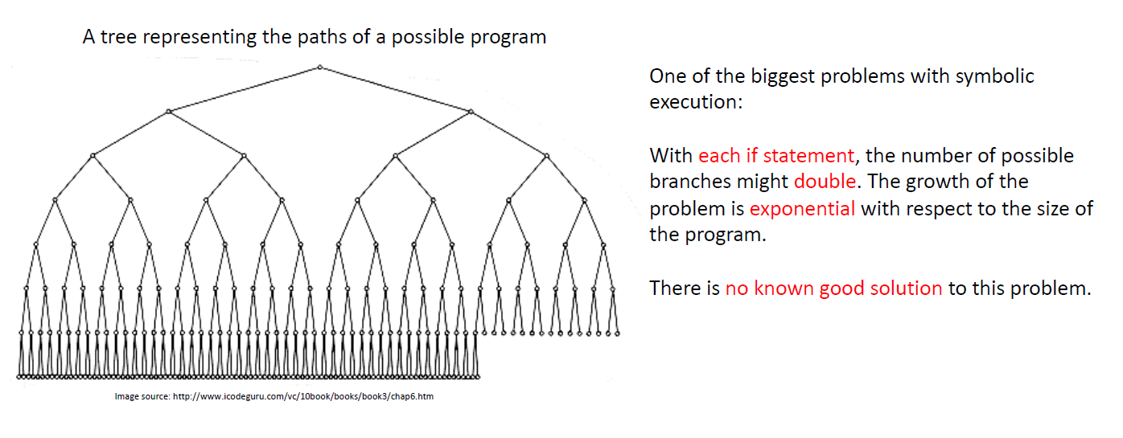
State Explosion (and a Solution?)

Slide 23
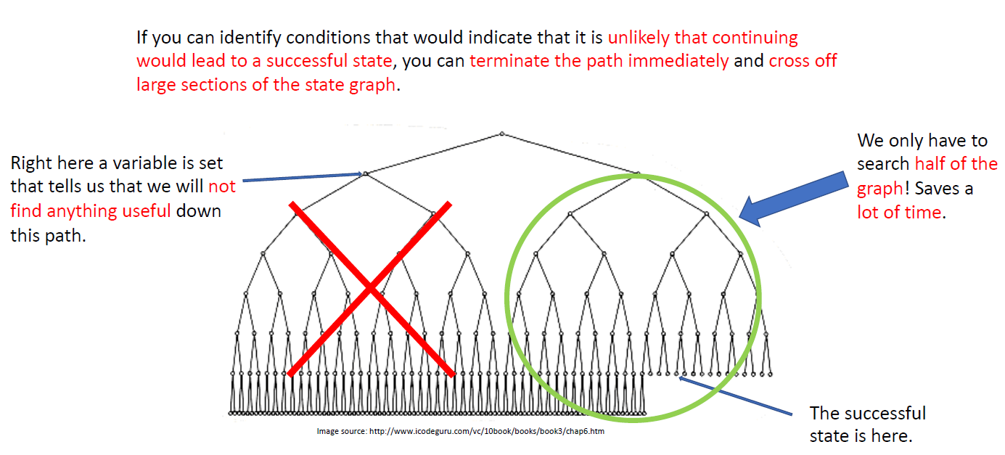
One Good Approach: Avoiding States

Slide 24

How do we step through the program, find
the branch we want, and solve for λ?
Angr !!
We let the computer do that! Our friends at UCSB built a powerful tool
called Angr to do that for us. It’s written in Python and it operates on native
binaries (no source code required!).
https://github.com/angr

Slide 25

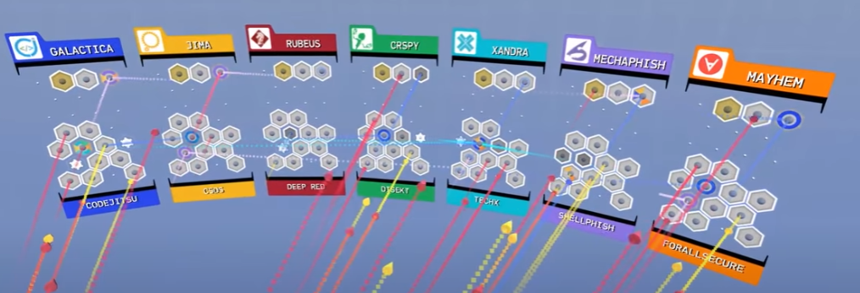
DARPA's Cyber Grand Challenge
MECHAPHISH : name of the winning team .

Slide 26
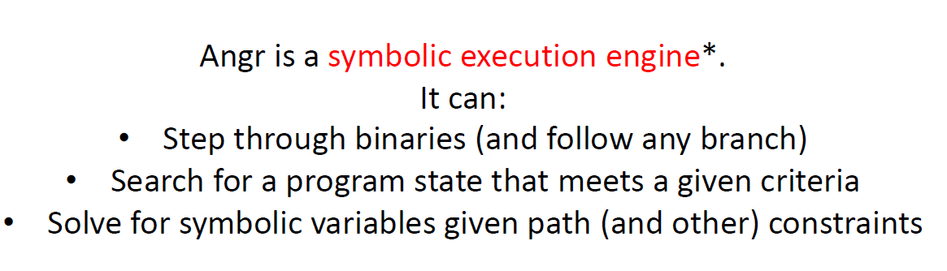
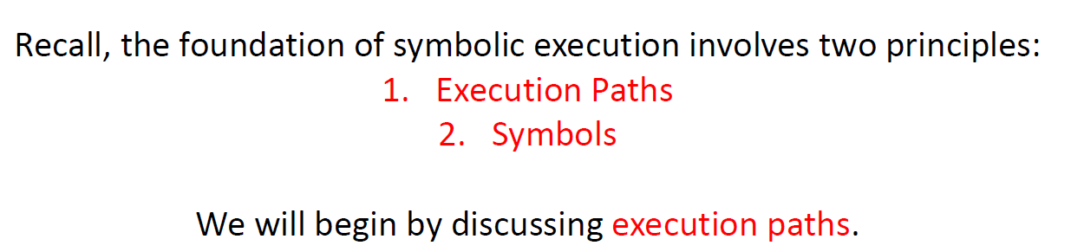
What is Angr?

Slide 27
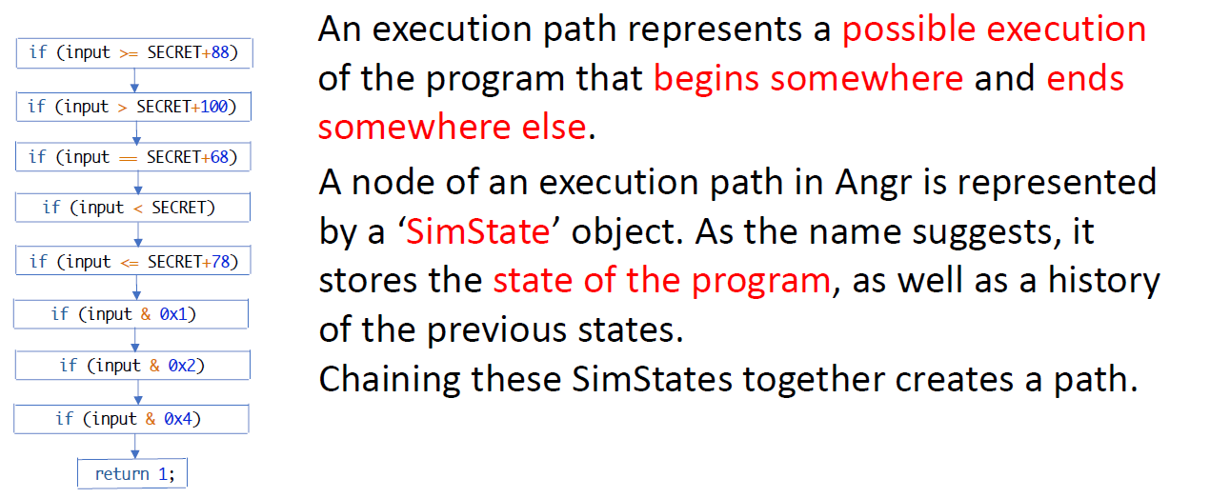
An Execution Path in Angr

Slide 28
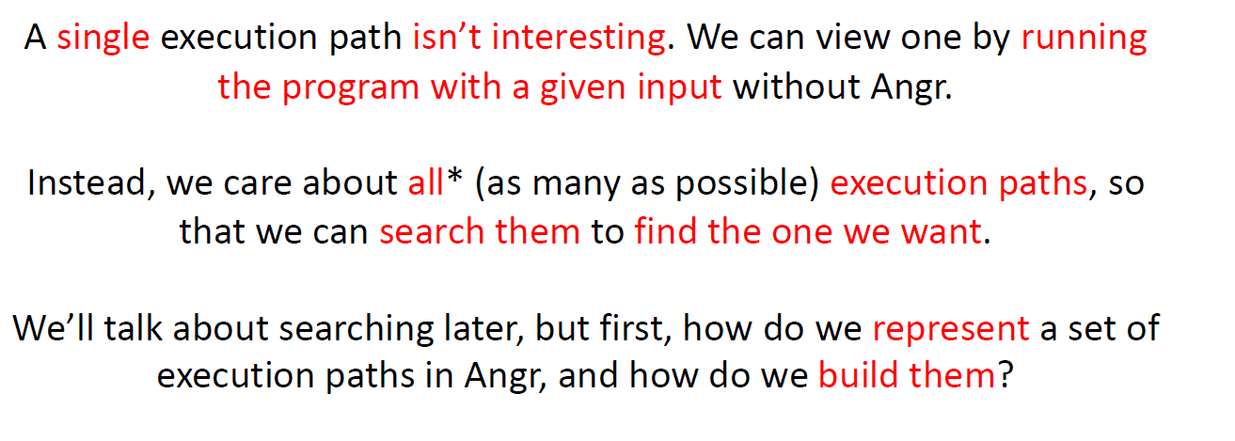
A Set of Execution Paths

Slide 29
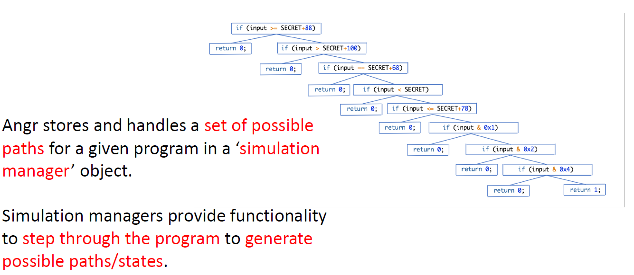
A Simulation Manager (simgr) in Angr

Slide 30
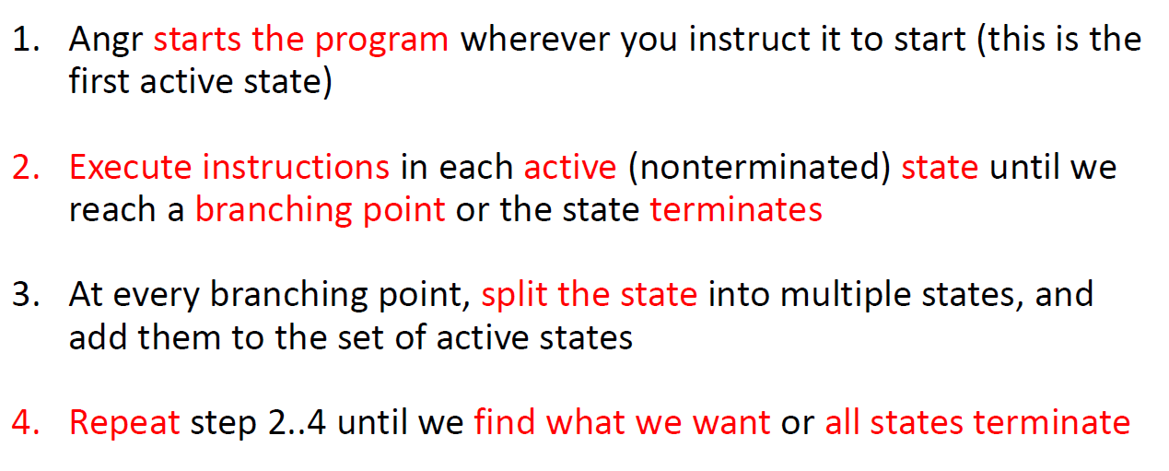
Building a Set of Paths

Slide 31
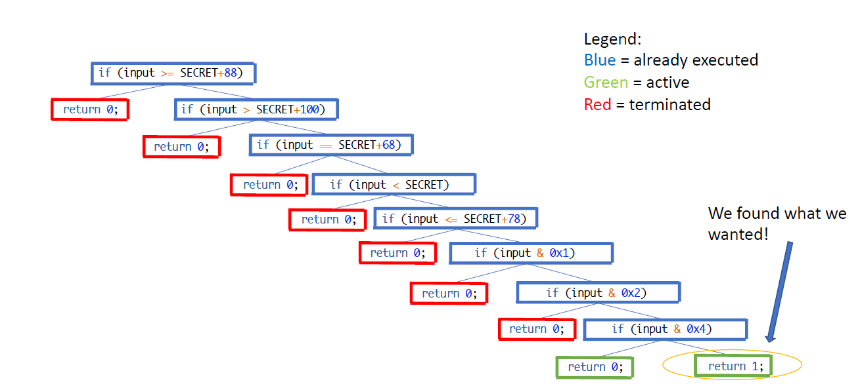

Slide 32
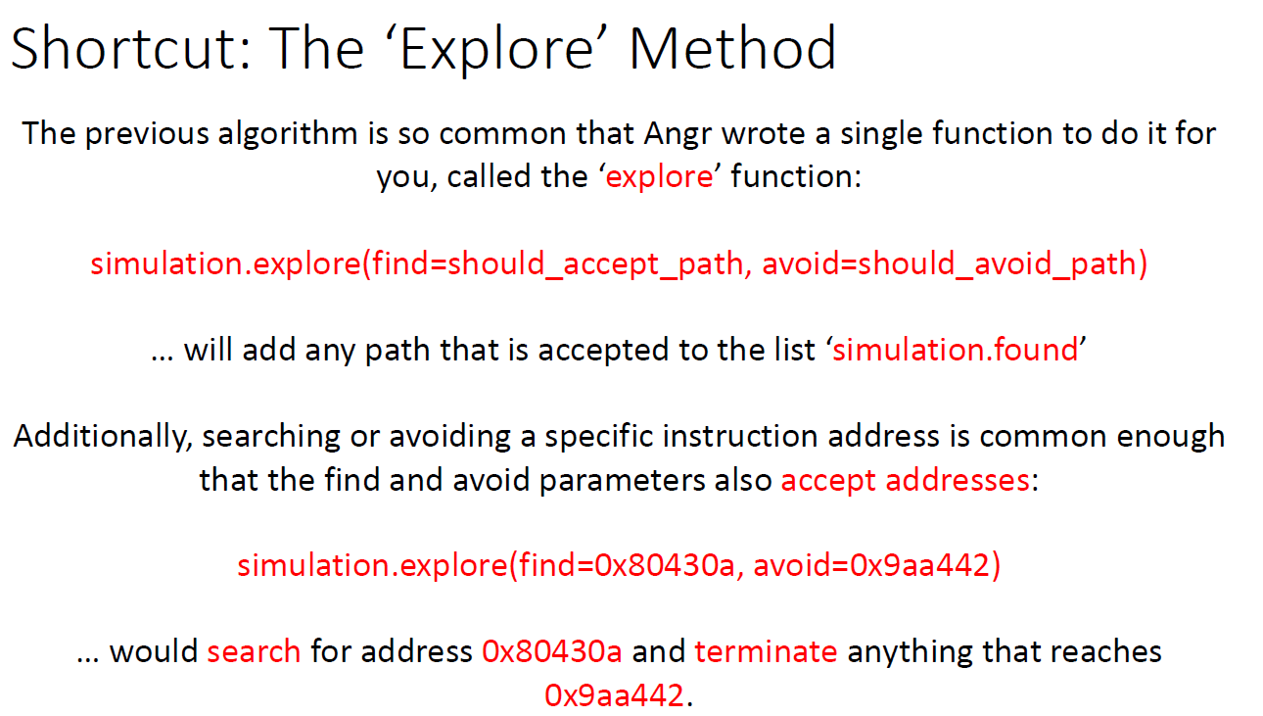

Slide 33
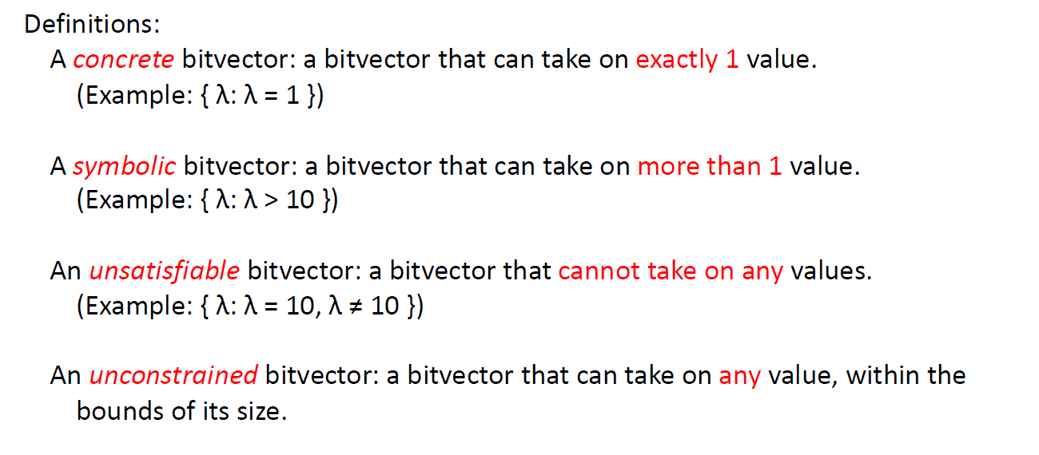
Between Symbolic and Concrete

Slide 34
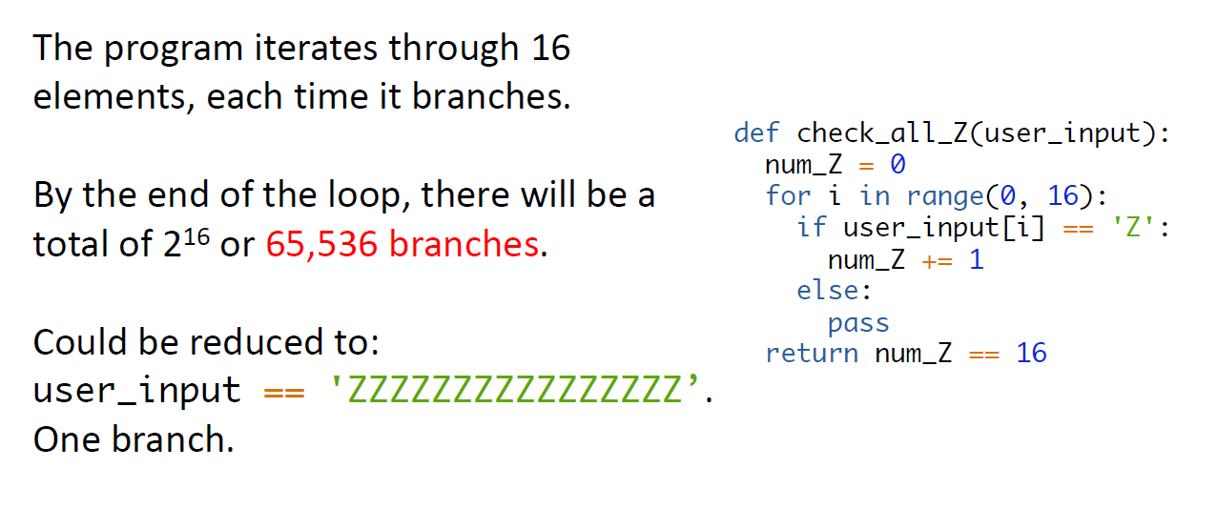
Motivation: A Simple Example

Slide 35
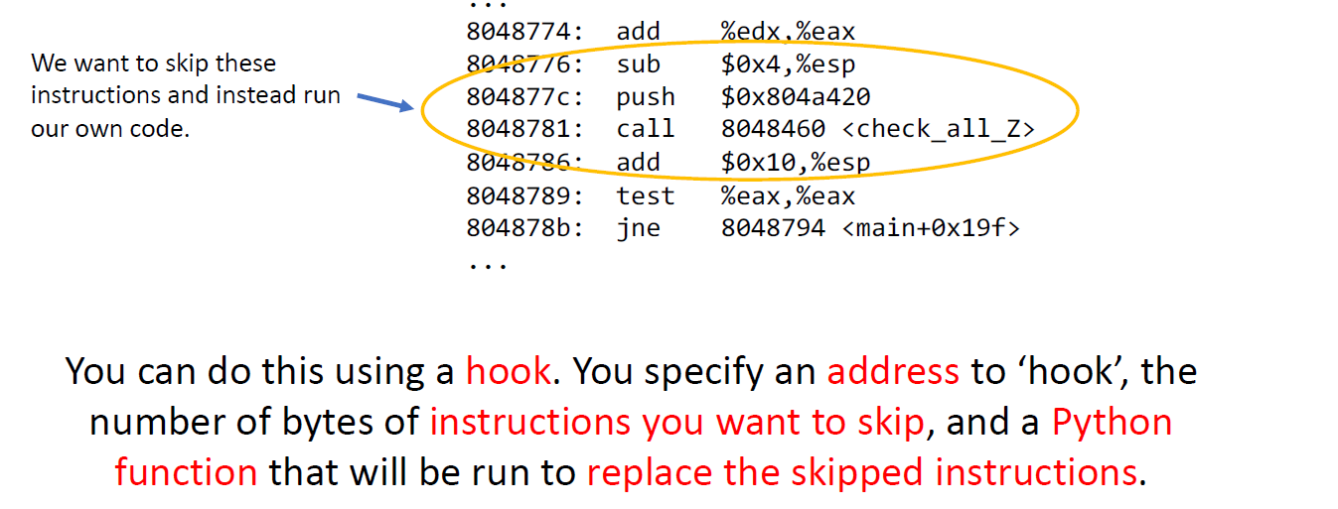
Hooks

Slide 36
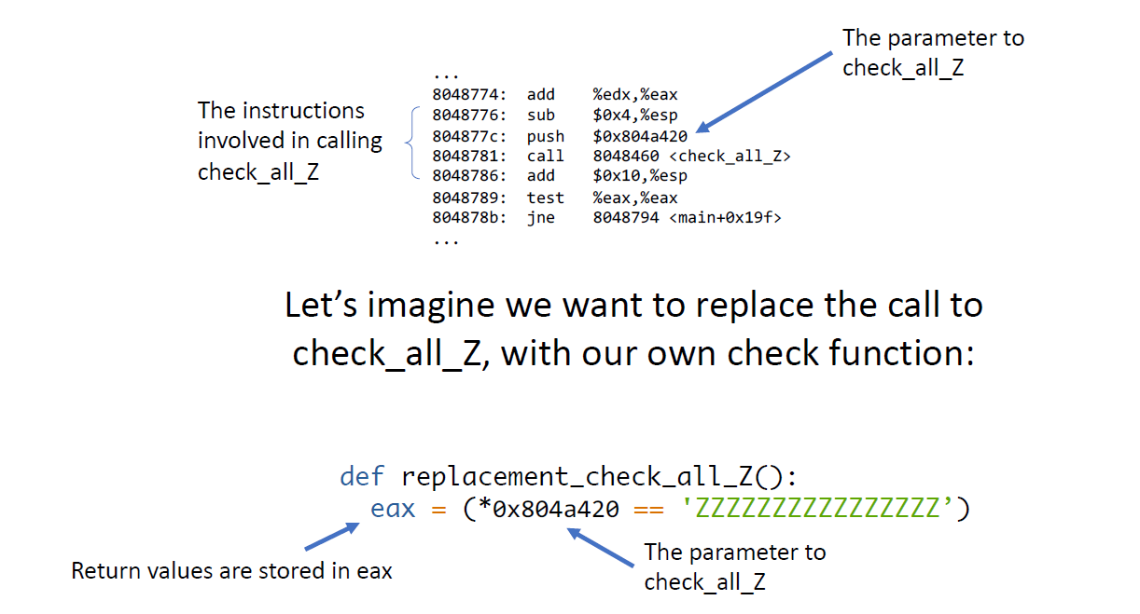
Step 1

Slide 37
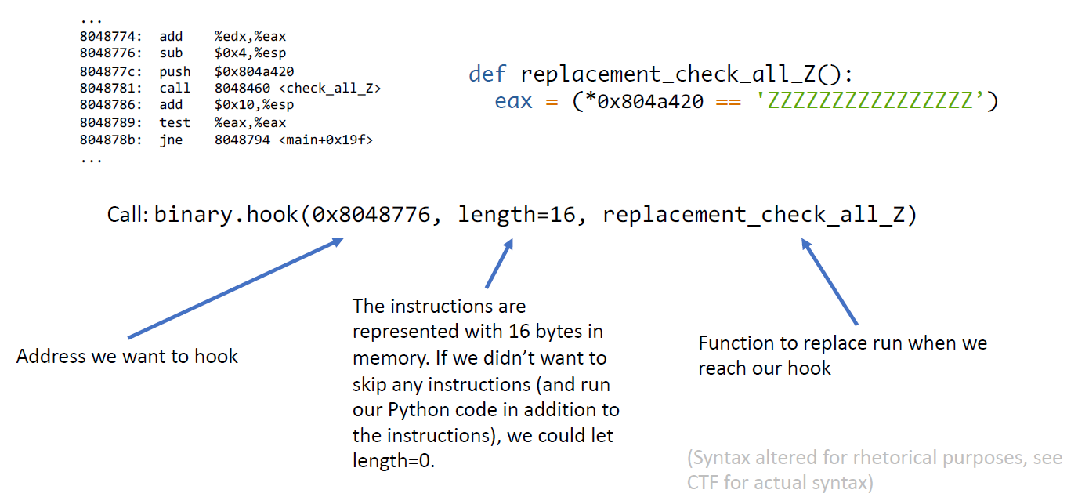
Step 2

Slide 38
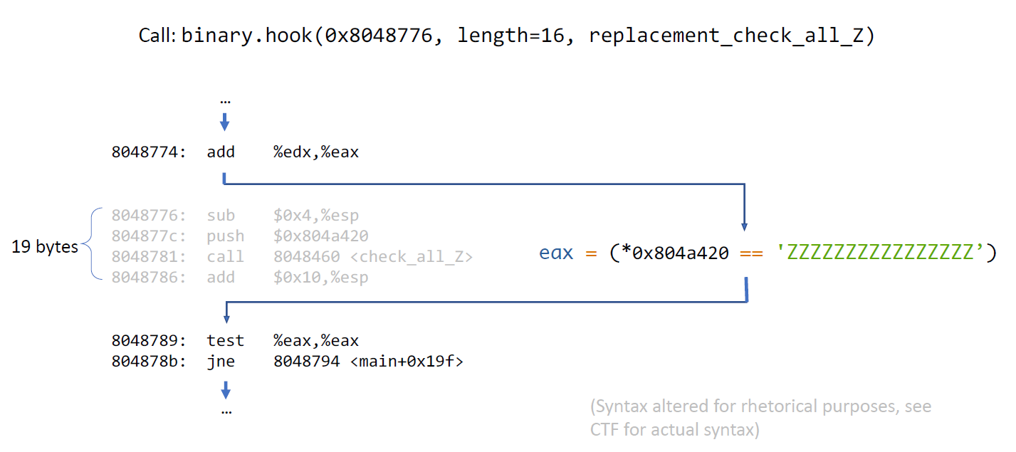
Step 3

Slide 39
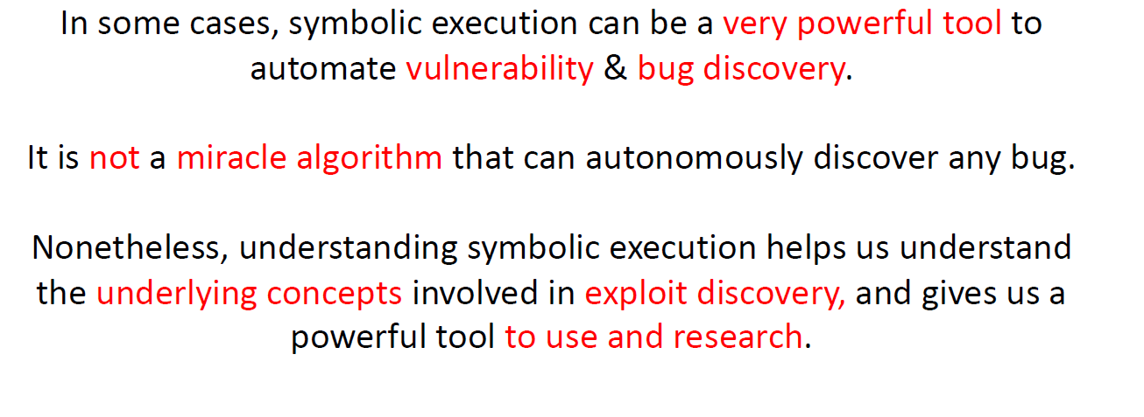
Conclusion

Slide 40



Thanks , Questions ?
Names of Authors : Joss Lalou , Nathane Baranes
Mail :
jlalou@jct.ac.il
nathanebar@jct.ac.il
Questions: in piazza

Slide 41

The demo
Test of one of the level 1a/1b/1c/1d (from the Lab2 in Piazza)
Test try a 'house' challenge
Test of the code of an exercice’s student (from piazza )
(for all the tests carried out we will of course use ida to check the password, and we will test in the exe file.)

